Slide 1
Membership Renewal Campaign using CiviCRM
Presented by Susan Engeman
Training and Customer Support Manager
Cividesk, Cloud Solutions for non-profits

Slide 2
Membership Renewal Campaign
Defining the Campaign
Update data
Choose who will receive the renewal email and assign permissioned relationship
Configure on-line membership page
Decide how members will renew
Create the renewal email
Track and monitor the progress

Slide 3
Defining the Membership campaign
Add a Campaign Type “Membership”
Name the Campaign – be specific
Begin/End Date
Revenue goal
Link to membership page

Slide 4
Updating contact data
Find and Merge Duplicates
Email addresses: included in the contact record and are current
Search for contacts without an email address (Search Builder)
Search for bounced emails (Advanced Search)
Correct email addresses
Make phone calls to members to obtain information.
Add new contacts and input new information to existing contacts
Notes:
Bounced emails are an Activity type

Slide 5
Which contact will receive the Renewal Email?
Organization type members: Select a primary contact
Assign the permissioned relationship
Email communications will only be sent to the employee with the permissioned relationship.

Slide 6
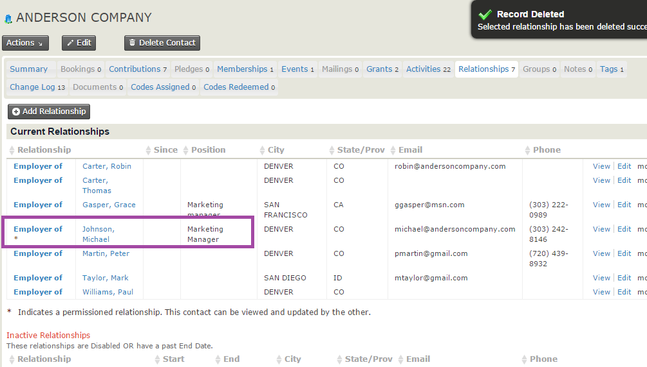
Permissioned Relationship

Slide 7
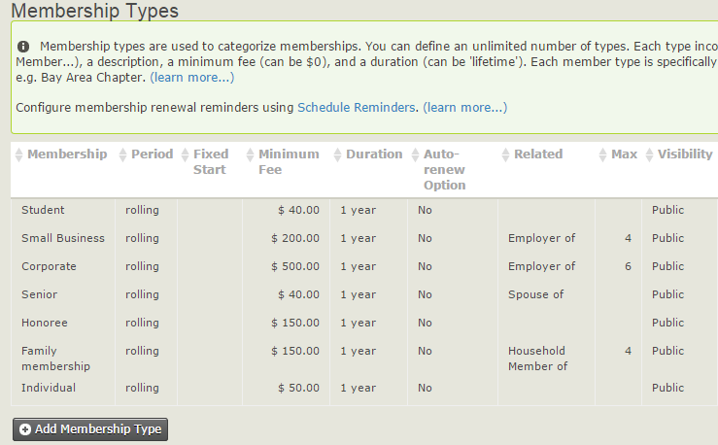
Updating Membership Types
Titles
Pricing
Max related
Auto-renew
Period type (fixed vs. rolling)

Slide 8
Configuring the membership page - CiviMember
May need more than one membership page
Individual vs. corporate
Gathering specific information about a particular membership type
Decide if you want to accept payments off-line (pay later option)
Update profiles: good opportunity to collect data about members when contacting them via email for renewal
On Behalf of an Organization (reserved)
Supporter (Individual) profile (user defined)

Slide 9
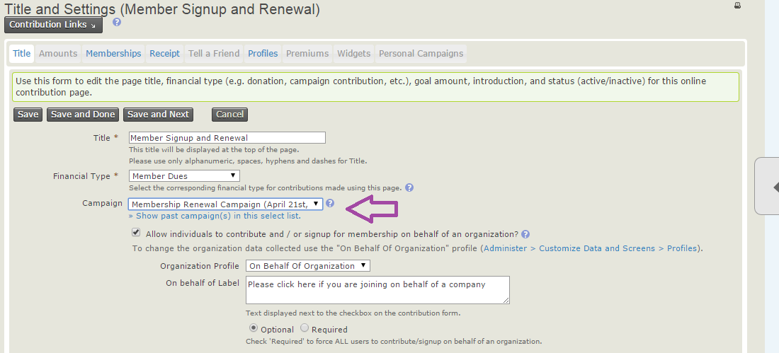
Membership Page

Slide 10
Membership Renewal options – decide how members will renew
Member Logs-in to CMS and renews
Send Email to members with a special link using checksum and contact tokens
Use both methods by having members log-in and include the special link.

Slide 11
Special Link for membership renewal
A special link to the membership page inserted in the renewal email.
Internal contact id token {contact.contact_id} identifies the specific contact record
Checksum token {contact.checksum} which functions as a password to allow the contact to access their personal information
Allows the member to update their contact info and renew their membership.
The link is active for seven days
Example of special link:
……../crm/index.php?q=civicrm/contribute/transact&reset=1
&id=1&cid={contact.contact_id}&{contact.checksum}
Notes:
When a person clicks on the special link, the CRM will look them up in the database and prefill the renewal form with any data that exists in their record.
The link is by default active for 7 days, but this can be modified.

Slide 12
Create renewal emails using Schedule Reminders
Create several reminder emails to be sent before and after membership expiration date
Create customized emails that are specific to your membership types or status
Include instructions on renewal with log-in credentials or special link to renewal page.
By default, scheduled reminders will be sent to contacts who have opted out of bulk or email communications

Slide 13
Schedule Reminders

Slide 14
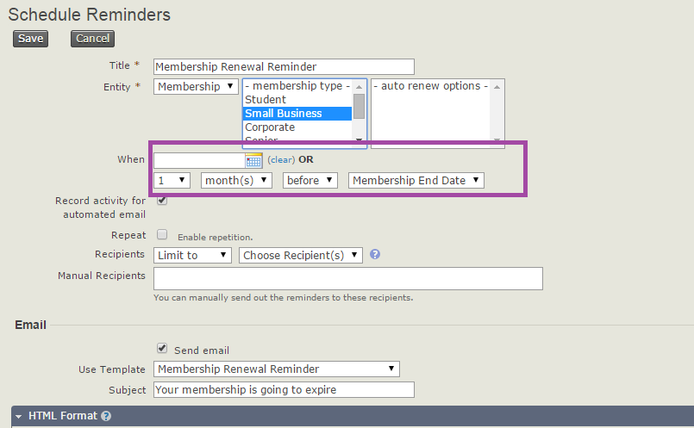
Schedule Reminders

Slide 15
Follow up: Create Smart Groups
Create smart groups to track who has/has not renewed their membership after receiving the renewal email
Use information to reach out to members via telephone or with an additional email communication
Follow up with renewals by sending a personalized thank you or with a phone call.

Slide 16
Monitoring the renewal progress with Reports - CiviReport
Create a Lapsed member Report to monitor the progress of the renewal campaign
Add report to Home dashboard

